Slide 1

From Zero to Production:
A Lightning Talk about our WebAssembly journey
Andrey Nagikh
WebPros, Bulgaria

Slide 2





Slide 3


Slide 4

A little about me
20+ years of experience
frontend, backend
love the web
love design
love cool technologies
deployed WebAssembly
Notes:
20+ years of web development
technical lead
senior software developer

Slide 5
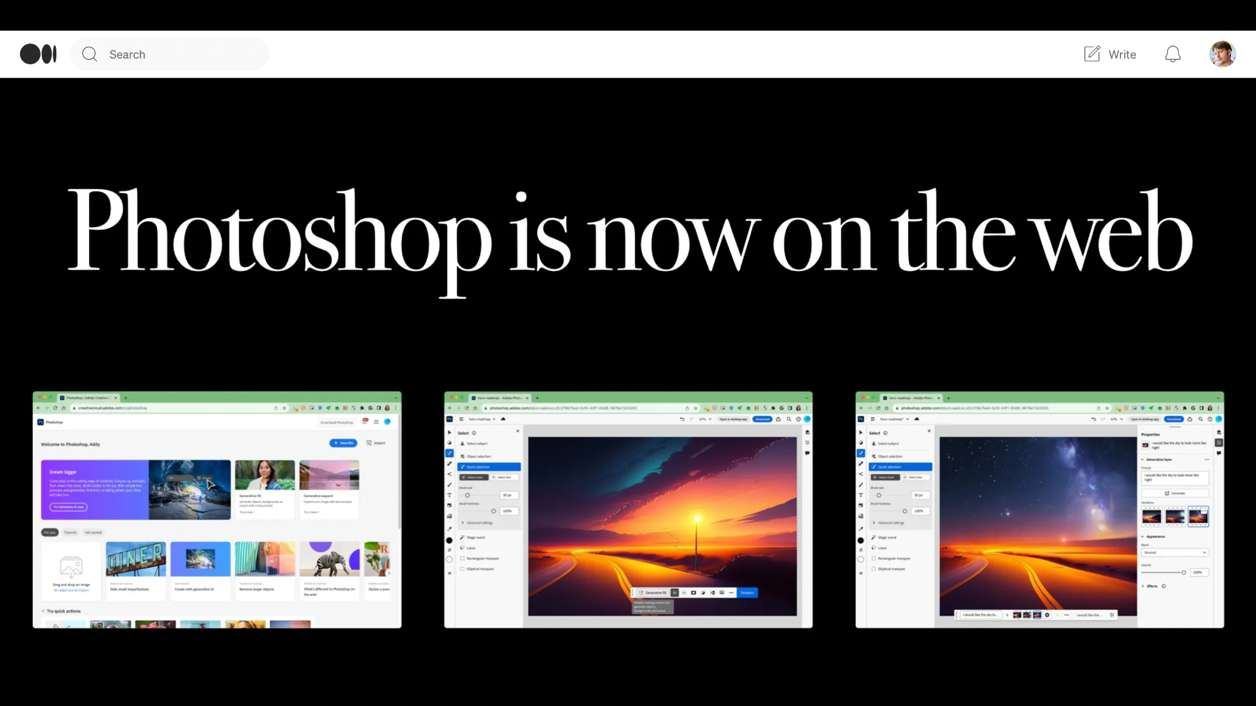

https://medium.com/@addyosmani/photoshop-is-now-on-the-web-38d70954365a

Slide 6

TV broadcasting service

Slide 7


Slide 8


Slide 9
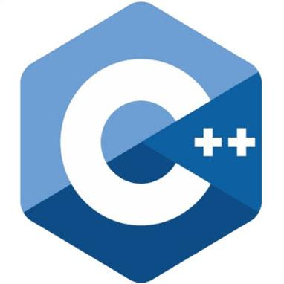
The App
900
classes
95k
lines of code

Slide 10
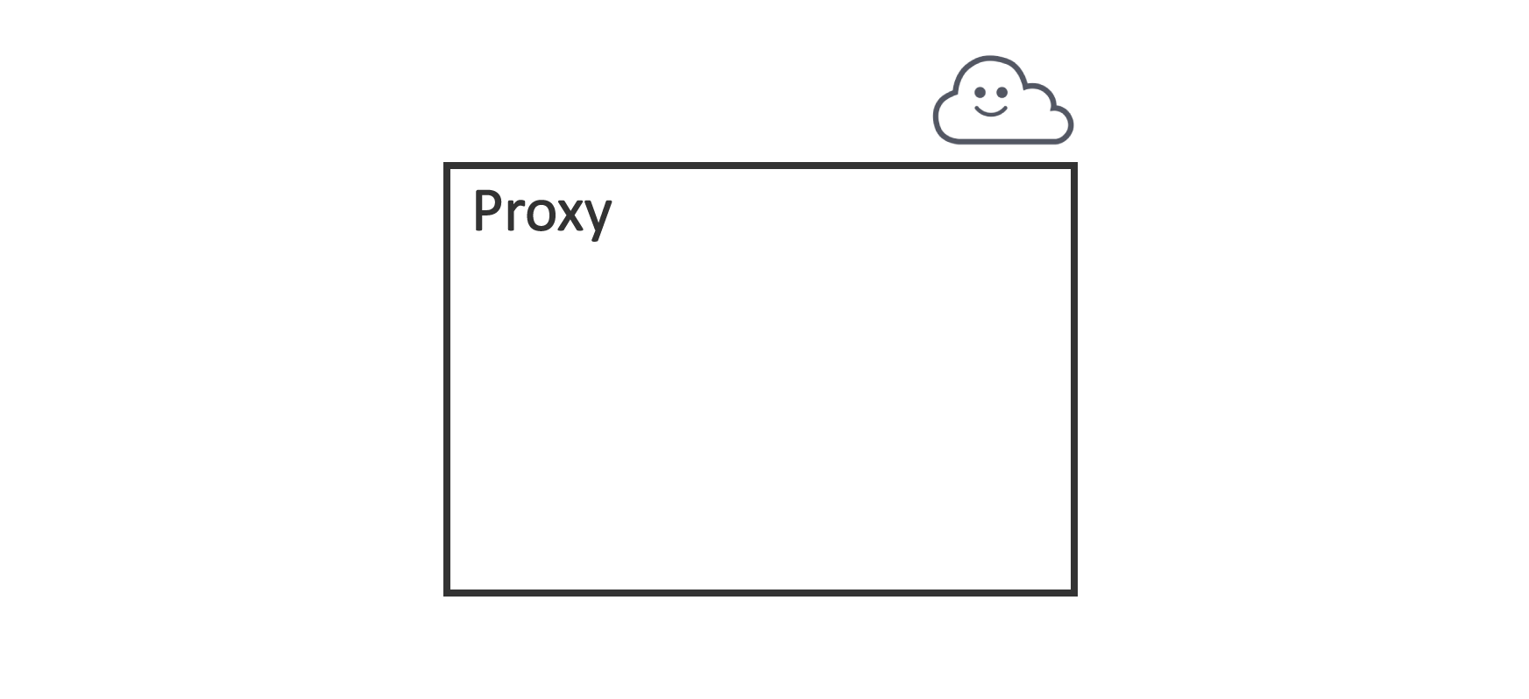
Architecture

Slide 11
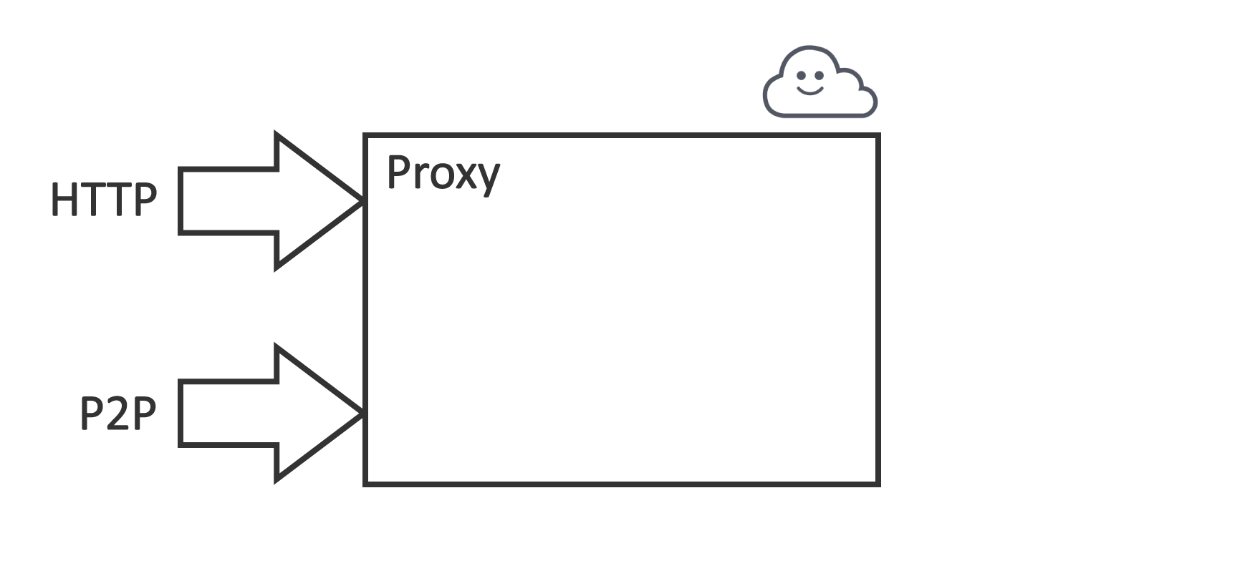
Architecture

Slide 12
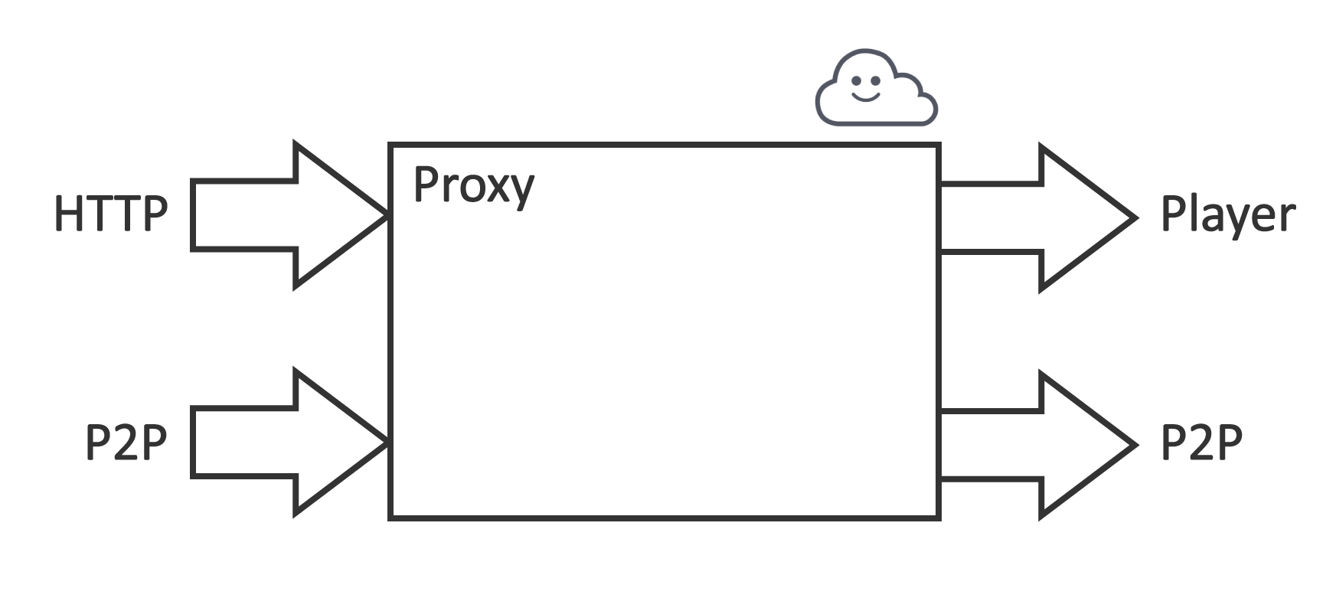
Architecture

Slide 13
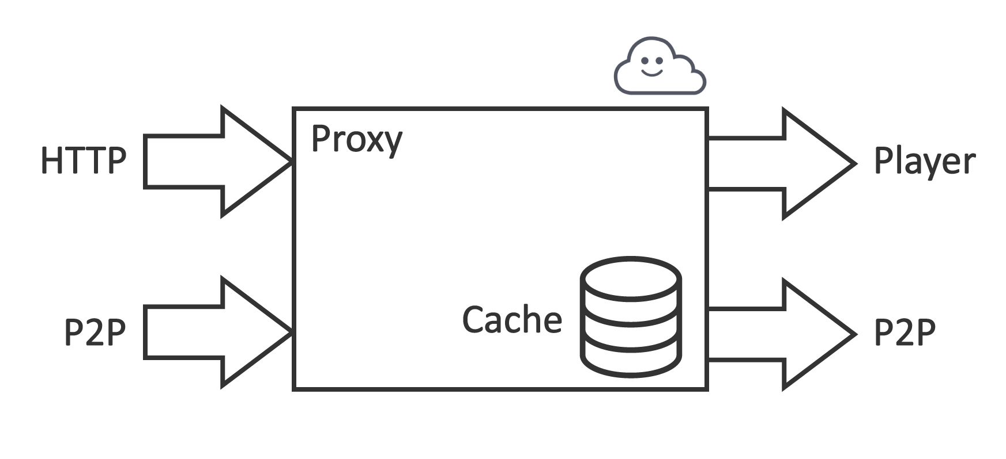
Architecture

Slide 14






Platforms
Windows, Linux, Android, iOS, Tizen, Web
Notes:
На чём будем писать? Java
Kotlin ?
JavaScript ?
ReactNative ???
C++ !

Slide 15

Notes:
The WebAssembly was the new hope after the NaCl implementation and older NPAPI plugins.

Slide 16




Browser support
Notes:
All major browsers have WebAssembly support since 2017.

Slide 17

The Goal
Port a C++ app to the browser,
leave the maximum code untouched

Slide 18

Notes:
Recreate the environment for C++ app
Pass C++ objects to JS side
Allow to call JS from C++ side

Slide 19
First thought
“We'll just compile it now with
Emscripten, and it will work out!”

Slide 20

OUR RAKES

Slide 21
Replacements
C++ | Wasm + JS
File System | Cookie, LocalStorage, IndexedDB
Network | XHR, fetch, WebSocket, WebRTC
Random | Math.random()
Async | Poll + setTimeout()
Graphics, 3D | Canvas, WebGL, WebGPU
Notes:
Вынести за интерфейсы то, чего нет в WASM
Реализовать на JS эту функциональность
При сборке под WASM использовать JS реализации

Slide 22

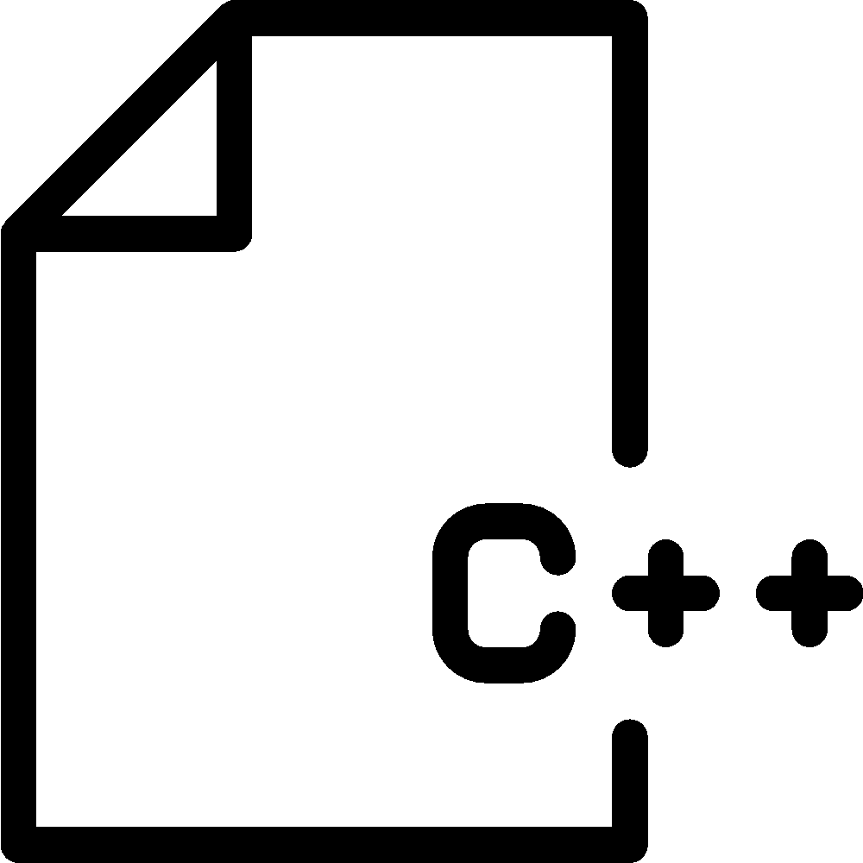
Interface

Slide 23
Find!

Slide 24

Saw off!

Slide 25

Saw off!

Slide 26

Saw off!

Slide 27

Saw off!

Slide 28

LINK TWO WORLDS

Slide 29
How to link the worlds?
ccall + cwrap (plain C functions)
WebIDL Binder (C++ functions, classes)
Embind (C++ ↔ JS)
Notes:
Functions ccall and cwrap does not support c++ mangled names
Embind over WebIDL additionally supports calling JavaScript code from C++.

Slide 30
Embind features
Call C++ functions from the JS side
Instantiate C++ class as a JS object
Call JS and Web API from the C++ side
Implement C++ interface with a JS object

Slide 31
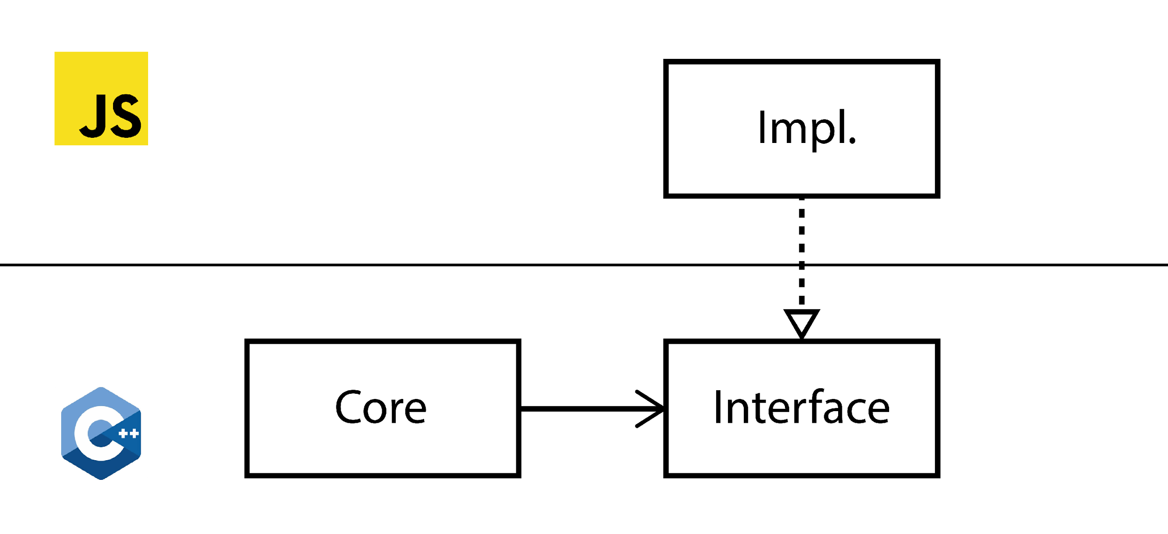
C++ interface JS implementation

Slide 32


Slide 33
C++ interface
class HTTPClient {
public:
virtual std::string get(std::string url) = 0;
};

Slide 34
C++ interface
class HTTPClient {
public:
virtual std::string get(std::string url) = 0;
};

Slide 35
C++ interface
class HTTPClient {
public:
virtual std::string get(std::string url) = 0;
};

Slide 36
Wrapper
class HTTPClientWrapper
: public wrapper<HTTPClient> {
EMSCRIPTEN_WRAPPER(HTTPClientWrapper);
std::string get(std::string url) {
return call<std::string>("get", url);
}
};

Slide 37
Wrapper
class HTTPClientWrapper
: public wrapper<HTTPClient> {
EMSCRIPTEN_WRAPPER(HTTPClientWrapper);
std::string get(std::string url) {
return call<std::string>("get", url);
}
};

Slide 38
Wrapper
class HTTPClientWrapper
: public wrapper<HTTPClient> {
EMSCRIPTEN_WRAPPER(HTTPClientWrapper);
std::string get(std::string url) {
return call<std::string>("get", url);
}
};

Slide 39
Binding
EMSCRIPTEN_BINDINGS(HTTPClient) {
class_<HTTPClient>("HTTPClient")
.function("get",
&HTTPClient::get,
pure_virtual() )
.allow_subclass<HTTPClientWrapper>
("HTTPClientWrapper");
}

Slide 40
Binding
EMSCRIPTEN_BINDINGS(HTTPClient) {
class_<HTTPClient>("HTTPClient")
.function("get",
&HTTPClient::get,
pure_virtual() )
.allow_subclass<HTTPClientWrapper>
("HTTPClientWrapper");
}

Slide 41
Binding
EMSCRIPTEN_BINDINGS(HTTPClient) {
class_<HTTPClient>("HTTPClient")
.function("get",
&HTTPClient::get,
pure_virtual() )
.allow_subclass<HTTPClientWrapper>
("HTTPClientWrapper");
}

Slide 42
Binding
EMSCRIPTEN_BINDINGS(HTTPClient) {
class_<HTTPClient>("HTTPClient")
.function("get",
&HTTPClient::get,
pure_virtual() )
.allow_subclass<HTTPClientWrapper>
("HTTPClientWrapper");
}

Slide 43

JS implementation
const impl = {
get: function(url) { … }
};
const client = Module.HTTPClient.implement(impl);

Slide 44
JS implementation
const impl = {
get: function(url) { … }
};
const client = Module.HTTPClient.implement(impl);

Slide 45
JS implementation
const impl = {
get: function(url) { … }
};
const client = Module.HTTPClient.implement(impl);

Slide 46
JS implementation
const impl = {
get: function(url) { … }
};
const client = Module.HTTPClient.implement(impl);

Slide 47
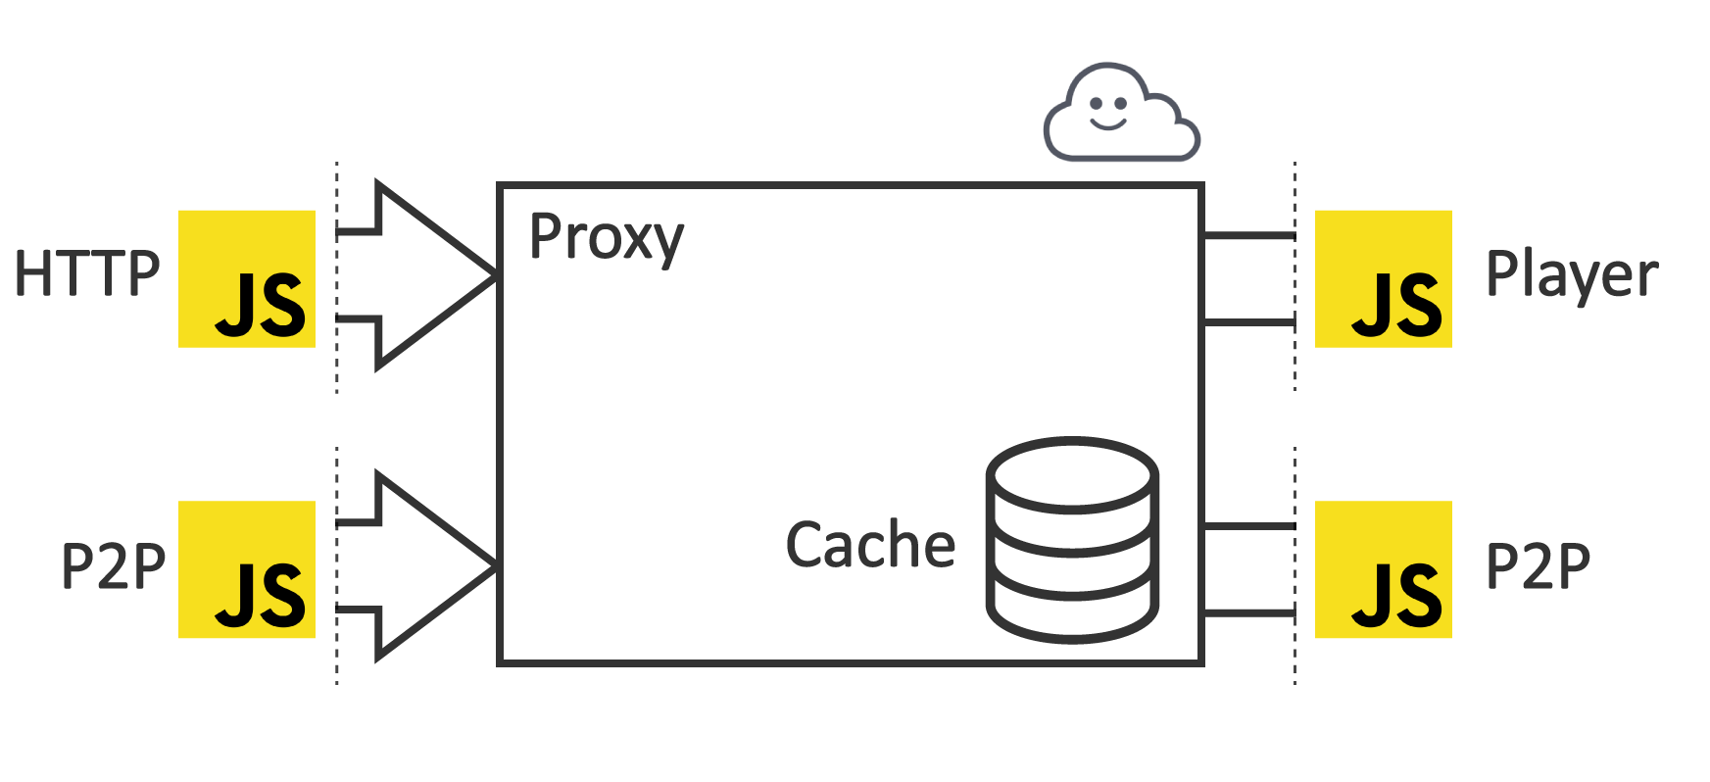
Result
XHR
HLS.js
WebRTC
WebRTC

Slide 48

WE’RE IN PRODUCTION!
Notes:
There was dropped 150 classes of native networking module.
About 30 classes were modified with interface, as described in this talk.
The whole process with debugging took 8 month for the team of 2 developers, c++ and js.

Slide 49
Production Pros
User doesn't need to install anything
Single codebase
We can debug on various platforms
Fast deploy
Fast feedback
Notes:
When do you need the WebAssembly?

Slide 50

USE CASES

Slide 51
Languages
C/C++
Rust
Go
.net
Lua
AssemblyScript (TS)
Perl, Python, PHP, etc.
Kotlin Wasm
https://github.com/appcypher/awesome-wasm-langs

Slide 52




Notes:
3D graphics and Games

Slide 53




Data processing
images
audio
video
archives

Slide 54
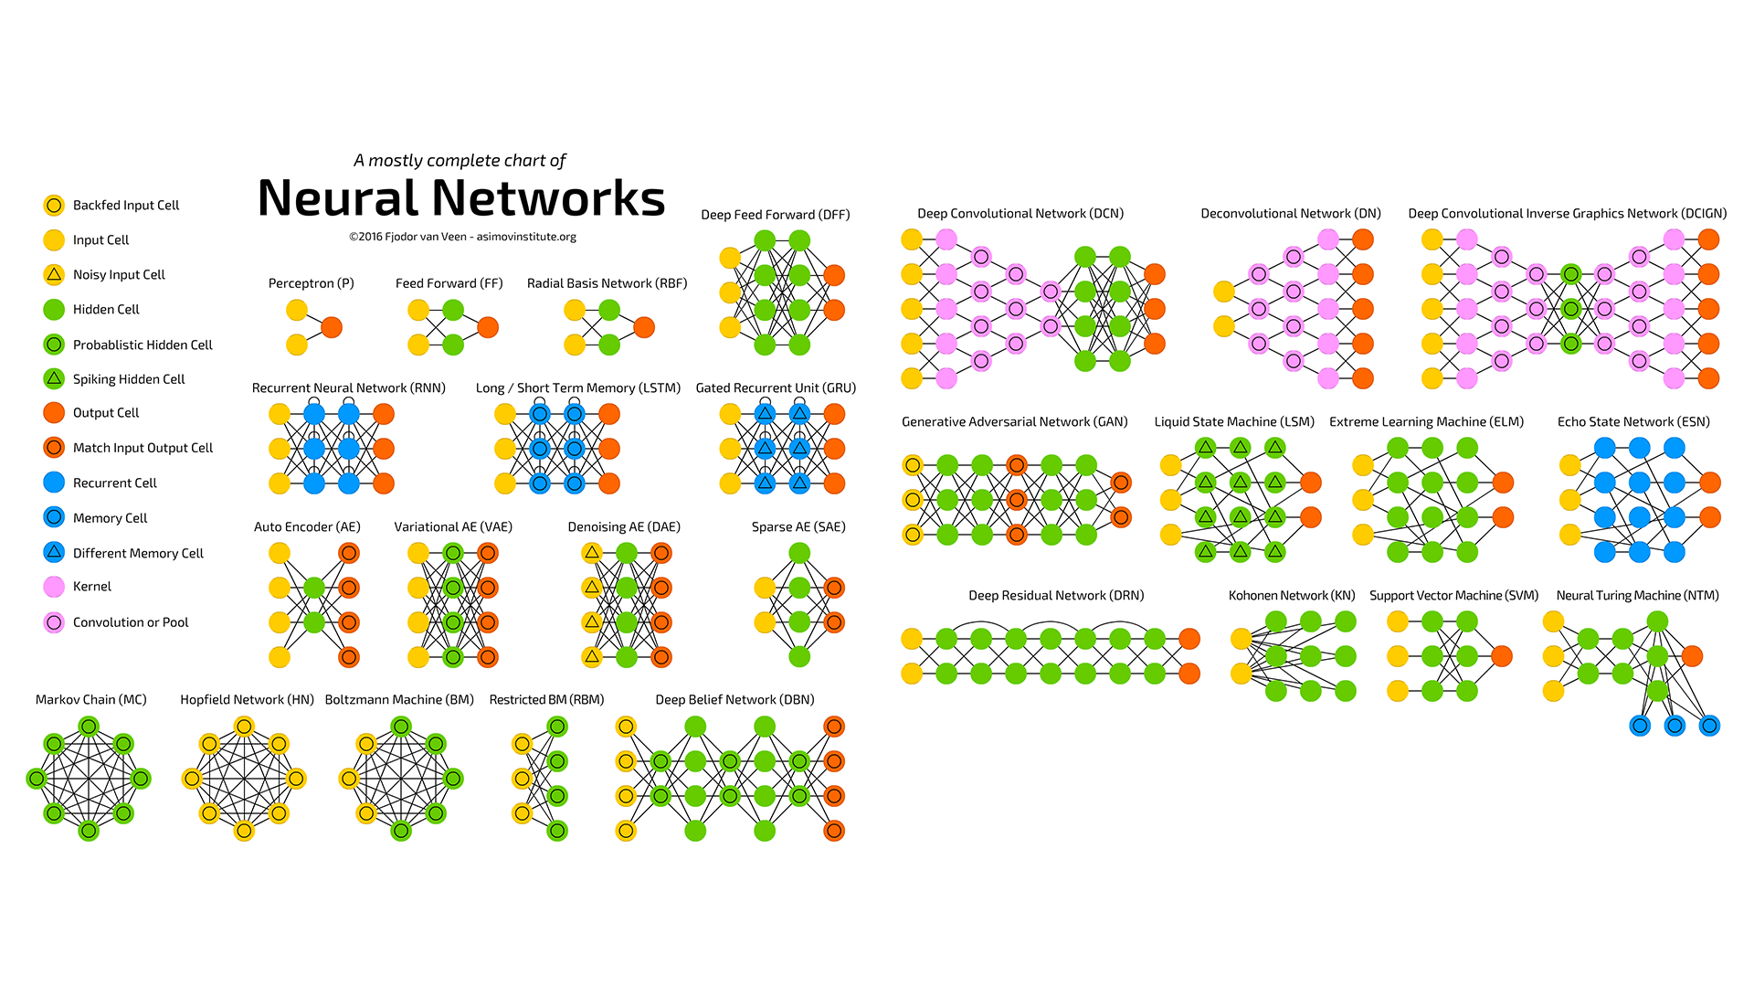
Neural Networks
Notes:
Neural Networks and ML-models
Run models right inside the User’s browser
Text language detection
Syntax highlighting

Slide 55

Notes:
Cryptography
Sign documents
Encrypt User’s data by password
e2e encryption for communication to the server

Slide 56





Notes:
Native Libraries compiled to Wasm:
SQLite
OpenCV
Opus
FFMpeg
RenderPDF

Slide 57
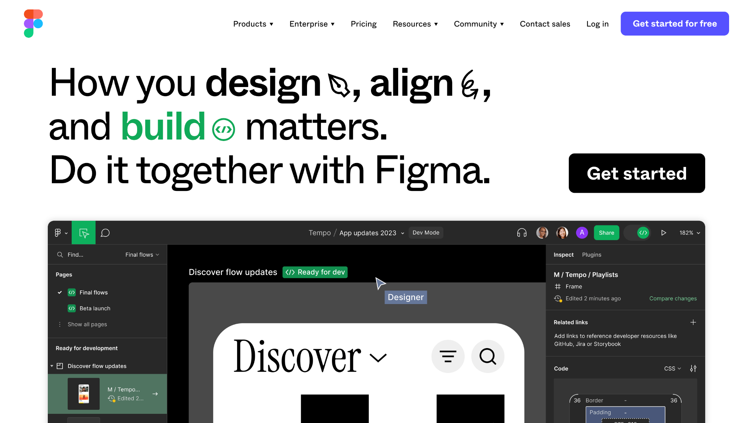
Notes:
Figma

Slide 58
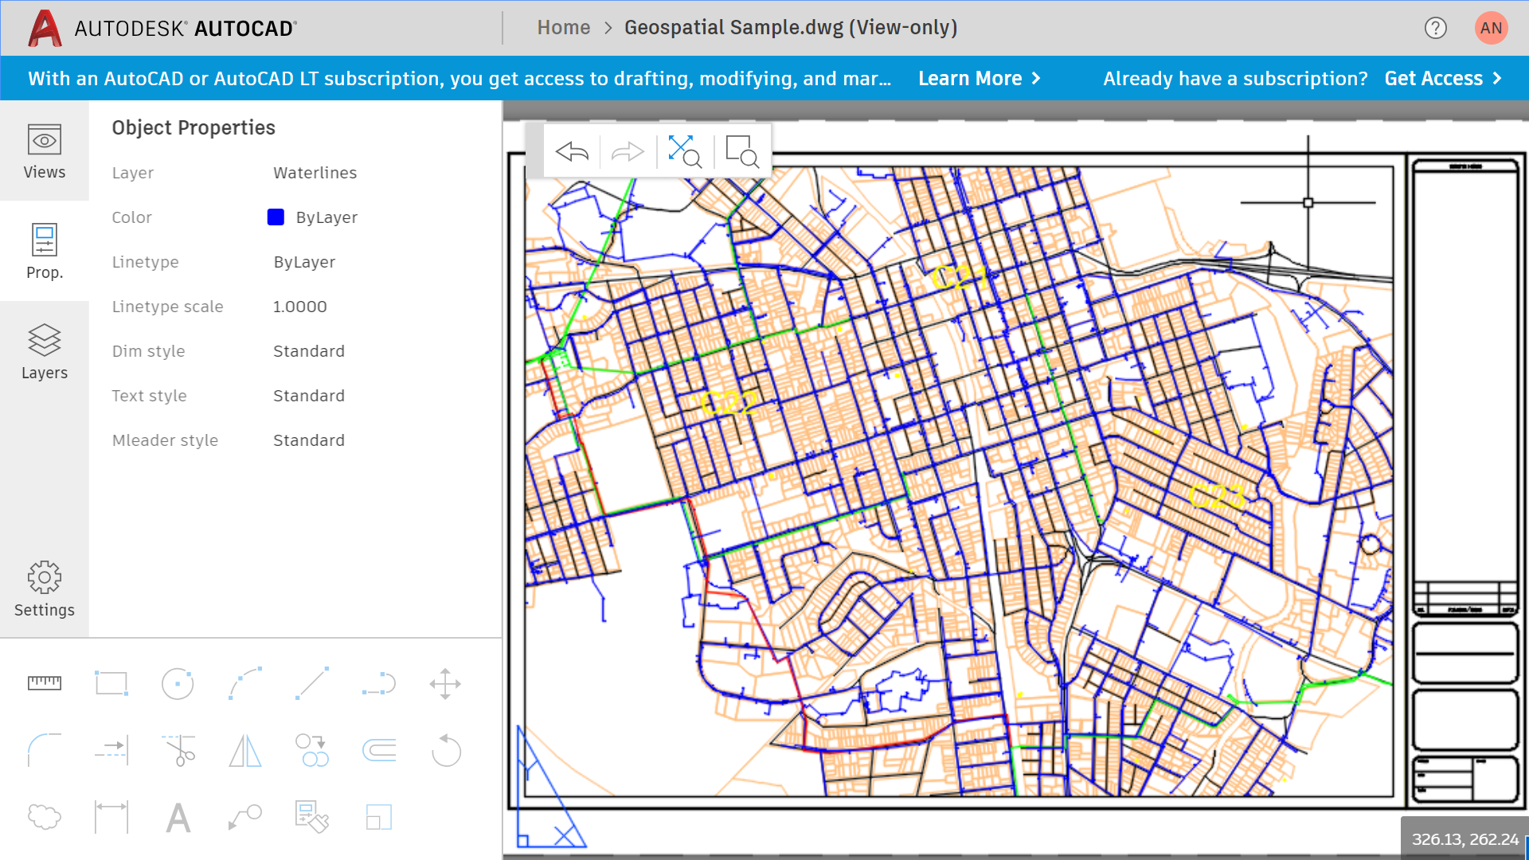
Notes:
AutoCad

Slide 59
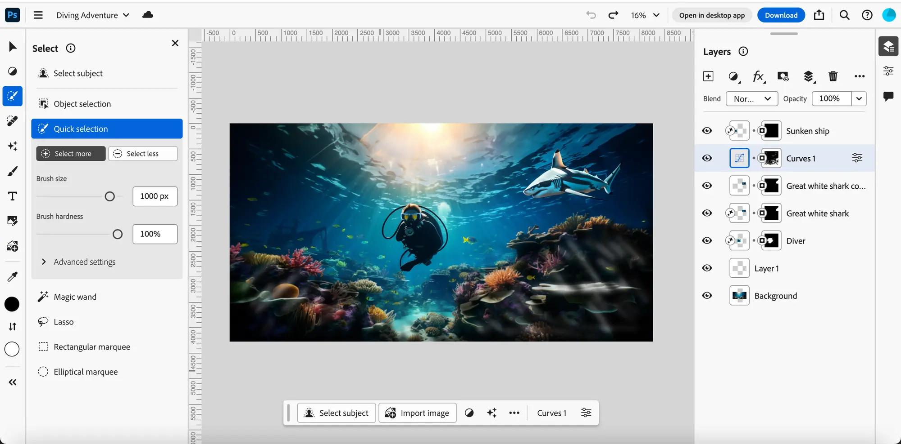
Notes:
Photoshop

Slide 60
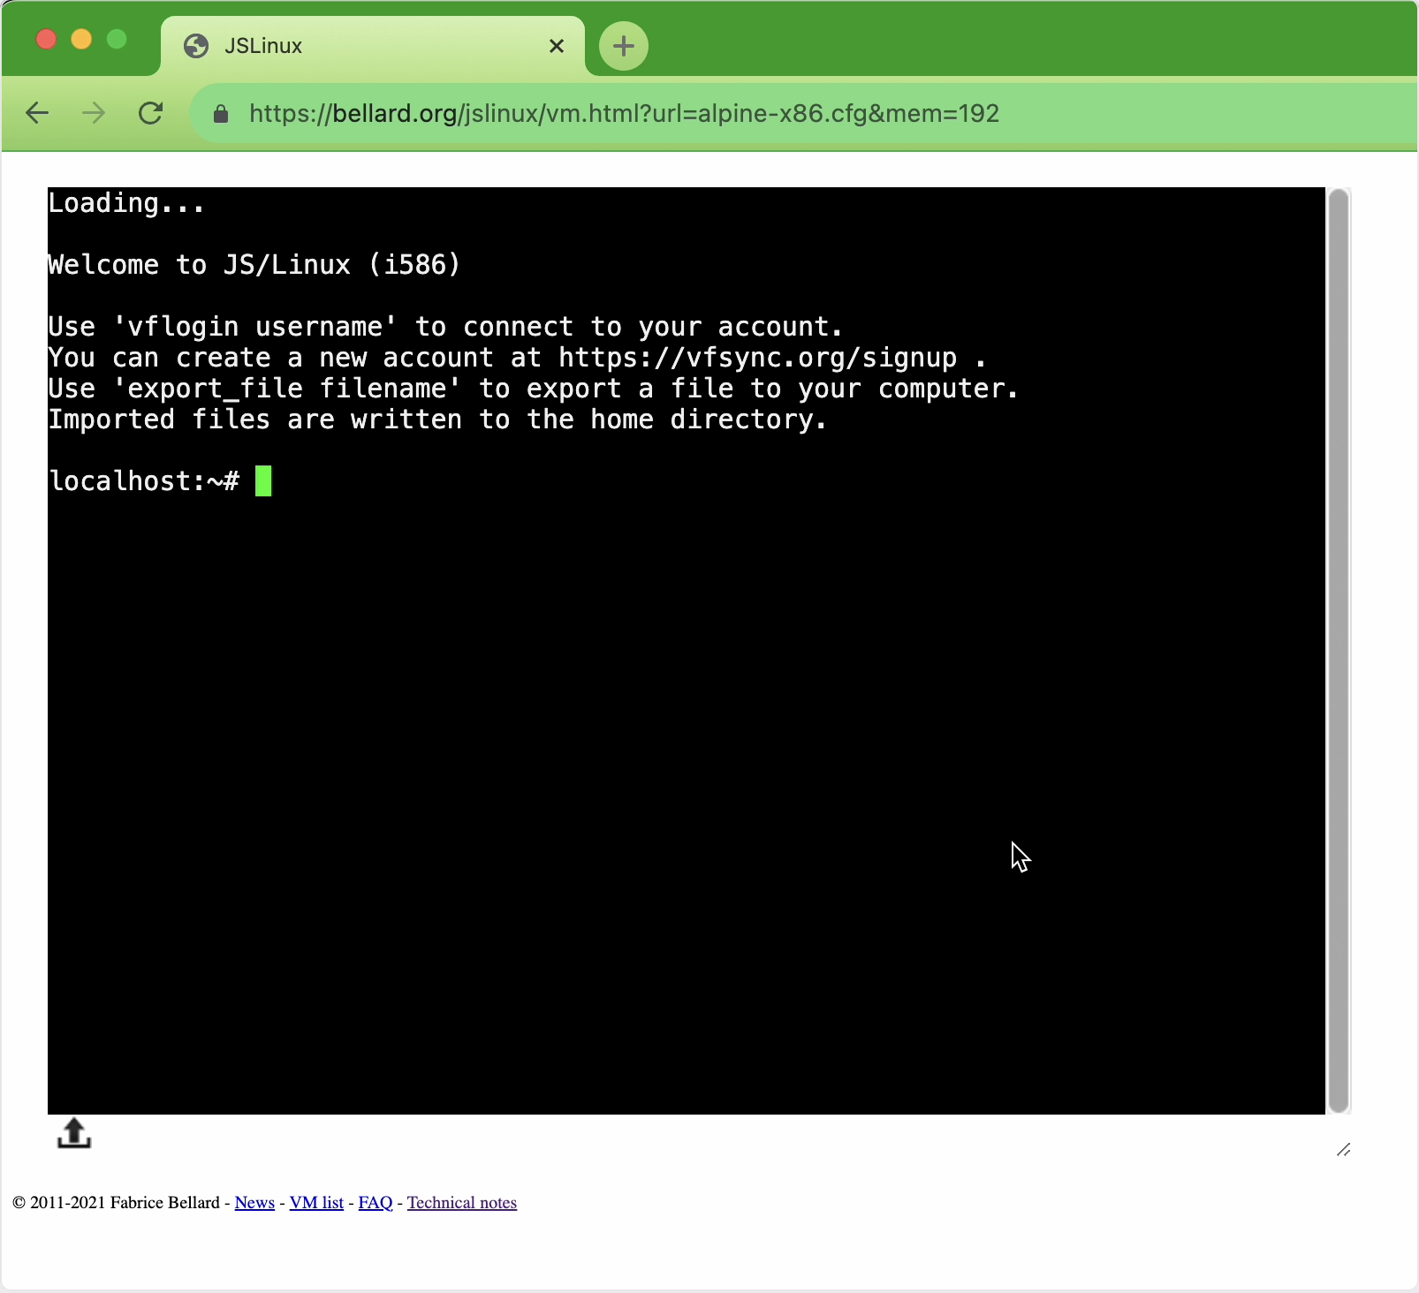
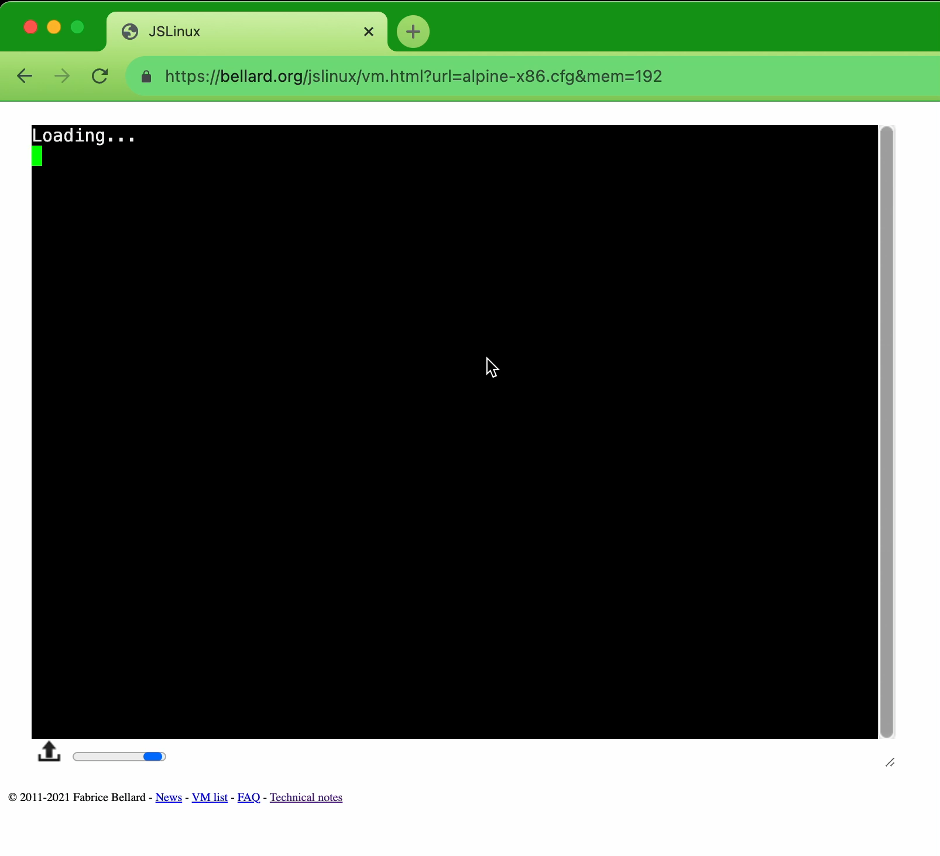
🤨
Notes:
JS Alpine Linux

Slide 61
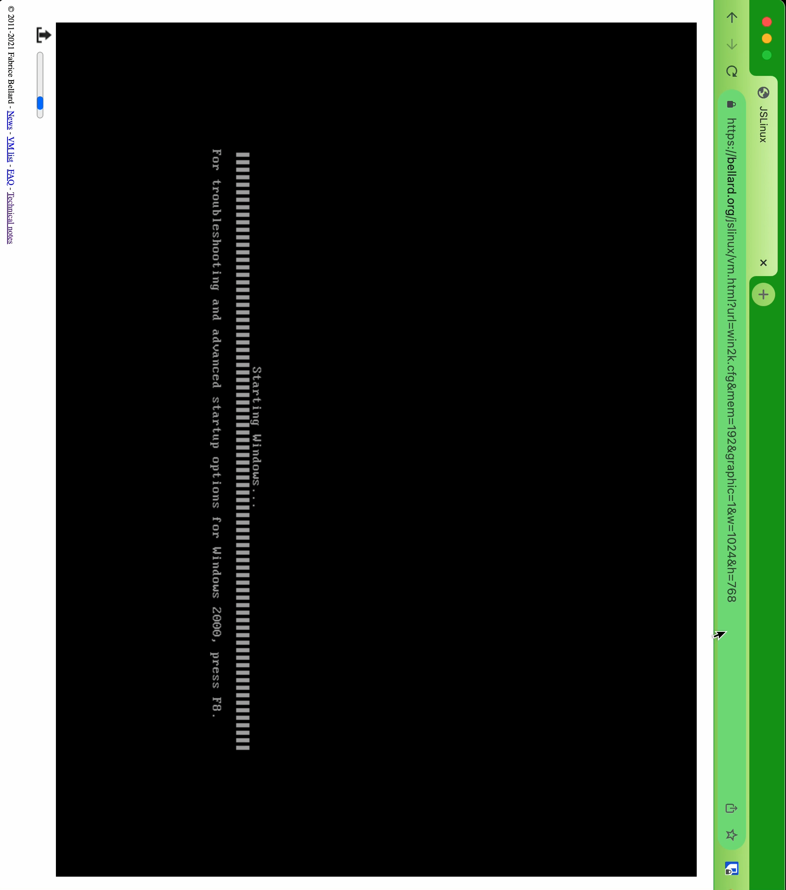
😎
Notes:
JS Windows 2000

Slide 62
Conclusion
WebAssembly is production ready
It is real to port even a large application
It took 8 months for team of 2 people
Tools are good enough
It has the speed of a good optimized JS code

Slide 63

Thank you! Questions?
Andrey Nagikh
Tech Lead, WebPros
t.me/andrnag
@andrnag
bit.ly/andrnag
All images were taken from Freepik, Vecteezy, Unsplash, Flaticon

